Slide 1
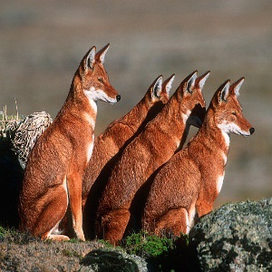
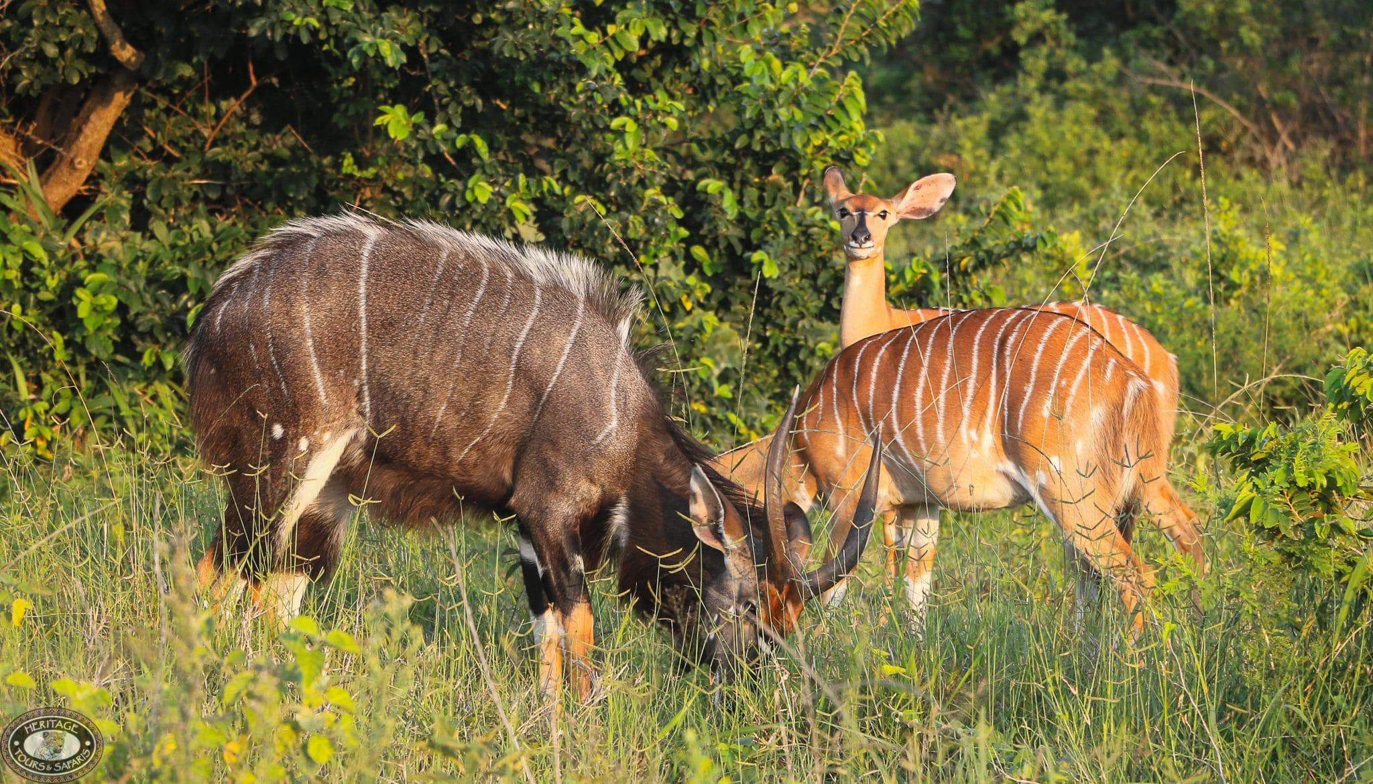
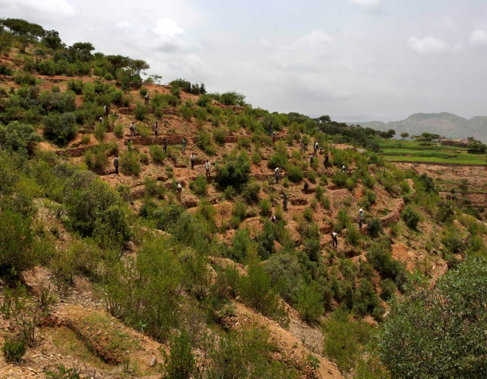
Chapter 6 Soils, Natural Vegetation and Wildlife Resources of Ethiopia & the Horn

Slide 2
Chapter Objectives
At the end of this chapter students will be able to;
Identify major soil types of Ethiopia
Understand soil degradation and conservation measures
Describe the distribution of natural vegetations in Ethiopia
Explain the significance of wildlife resources of Ethiopia

Slide 3
Outlines
Ethiopian Soils:
Meaning, Formation, Types, Degradation and Conservation
Natural Vegetation in Ethiopia
Meaning, Vegetation Types, Degradation and Conservation
Wildlife Resources of Ethiopia
Classification, Conservation

Slide 4
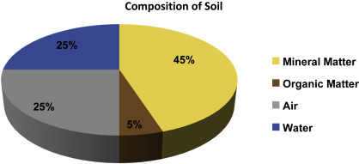
1. Ethiopian Soils
What is Soil?
The thin layer of material covering the earth’s surface and formed from the weathering of rocks
A delicate but highly varied composition of mineral particles, organic matter and living organisms in dynamic equilibrium.

Slide 5
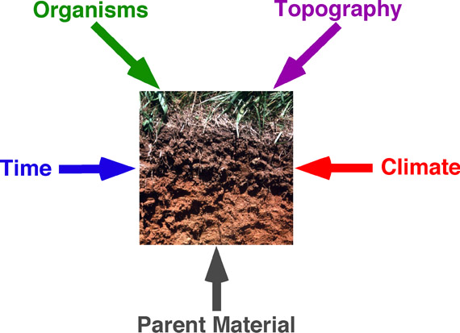
Soil Formation: How soil is formed?
A long-term complex process
Take several thousands of years to form a single stratum
The formation depends on the following factors

Slide 6
Soil Formation: How soil is formed?
Parent materials=
Organisms = soil formation influenced by organisms (such as plants), micro-organisms (such as bacteria or fungi), burrowing insects, animals and humans
Climate= soil formation influenced by elements of climate such as temperature and rainfall
It affects the rate of weathering and organic decomposition
Topography= The shape, length and grade of a slope affects drainage
Time= how long the soil has been weathered

Slide 7
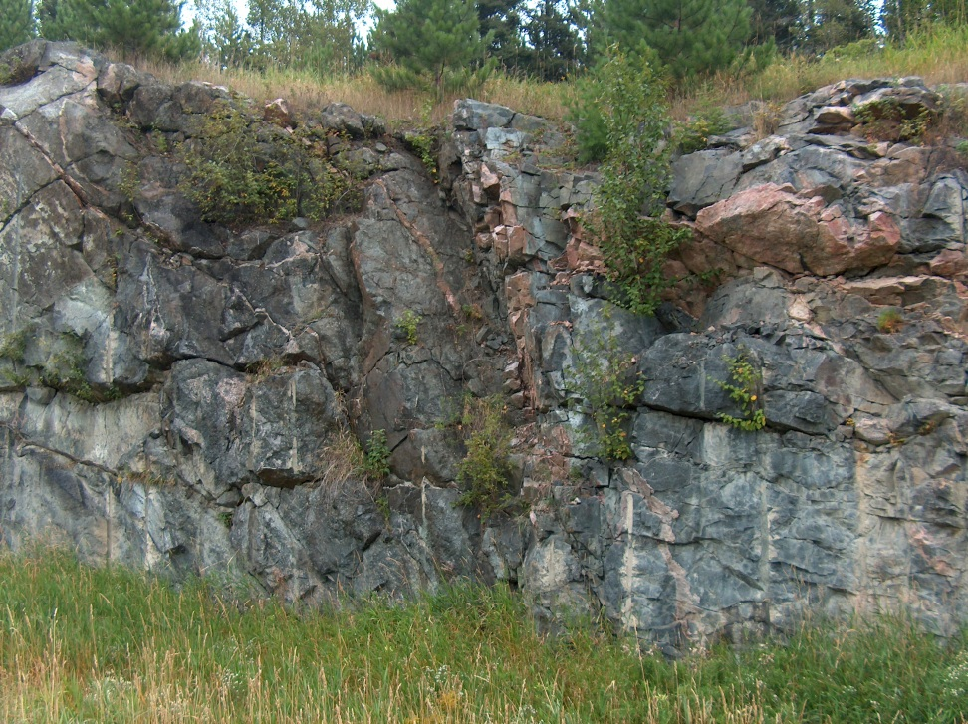
Weathering (as a Soil Formation Process)
The disintegration inorganic substances (rocks)
It is the breakdown of rocks at the Earth's surface, by the action of;
Rainwater,
Temperature, &
Biological Activity

Slide 8
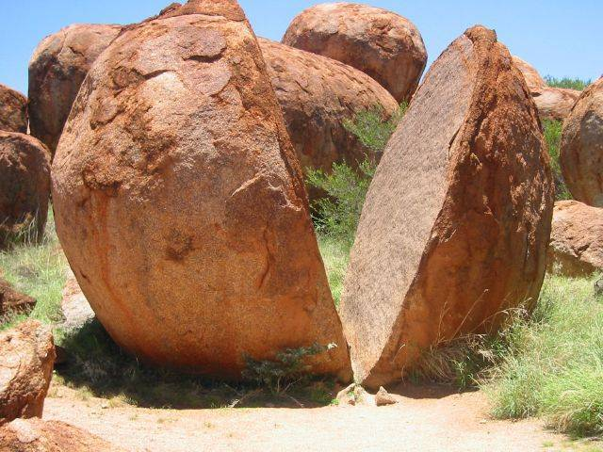
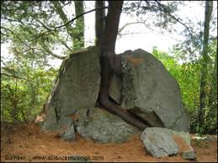
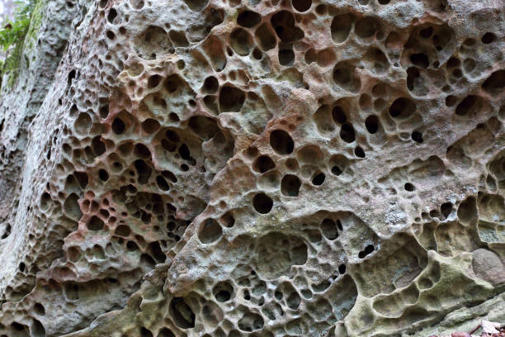
3 Types of Weathering involves in Soil Formation
Mechanical (Physical) Weathering
Differential stresses due to heating and cooling
Biological Weathering
Disintegration of rock by plants, animals & microbes
Chemical Weathering
modification of the chemical & mineralogical composition
(hydrolysis, oxidation, reduction, and solution)

Slide 9
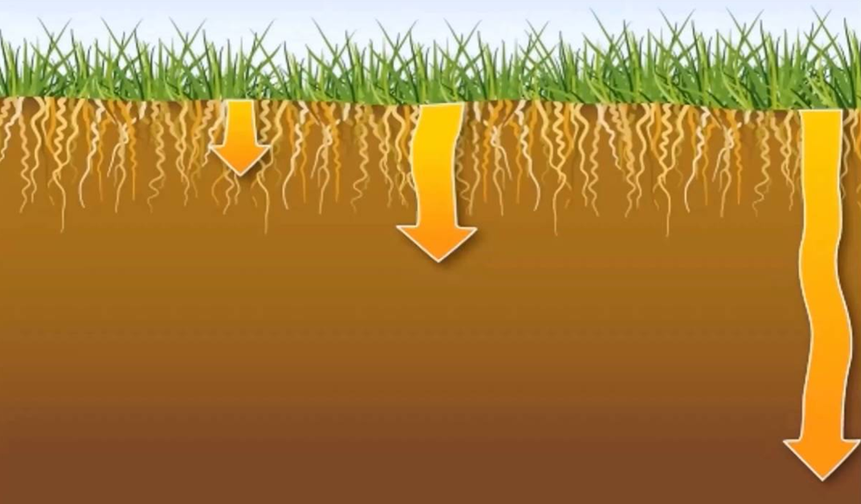
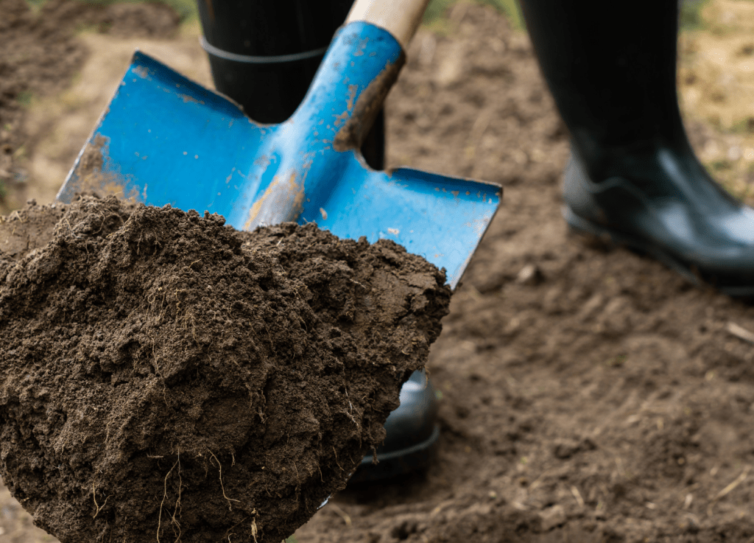
Soil Properties
Physical properties Soil
Chemical Properties
Properties which affect air and water movement in the soil, and thus the soil's ability to function
Texture,
Structure,
Porosity etc.
Chemical constituents which affect soil biological activity and nutrient dynamics
Availability of minerals,
Electrical conductivity,
Soil pH, etc.

Slide 10
Major Soil Types in Ethiopia
Soils of Ethiopia
are basically derived from crystalline, volcanic and Mesozoic sedimentary rocks.
FAO has identified 18 soil associations in Ethiopia
11 soil associations cover about 87.4% of the land area

Slide 11
6 major groups of soils in Ethiopia are discussed under the following points:
Environmental condition i.e. parent material, climatic conditions, topography, the way they were formed.
Characteristic i.e. significant chemical and physical properties.
Agricultural suitability in relation to texture, structure, topography, moisture-storage capacity, etc.
Occurrence: general location of the soil types

Slide 12
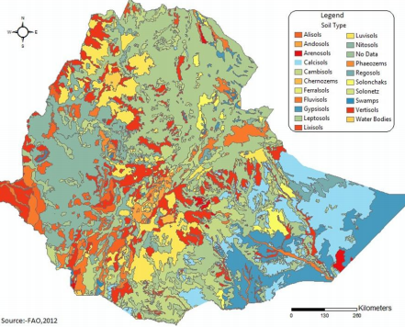
The 6 Major Groups of Soils in Ethiopia
Nitosols and Acrisols
Vertisols
Lithosols, Cambisols & Regosol
Xerosols, Yermosols & Solanchaks
Fluvisols
Luvisols

Slide 13
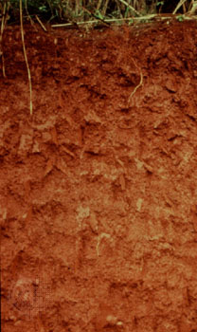
1. Nitosols and Acrisols
Nitosols
Trap series volcanics, volcanic ash, metamorphic rocks parent materials
Associated with highlands with high rainfall
Reddish-brown color
concentration of iron (ferric) oxides due to leaching
western highlands (Wellega)
southwestern highlands (Kaffa, Illuababora)
Southern, Central and Eastern highlands
Acrisols
Most inherently infertile soils
Degraded chemically and organically
Low resilience to degradation
Low productive capacity
Acrisols are found along with nitosols mostly in some pockets of southwestern highlands of Ethiopia where there is high rainfall.
Notes:
Leaching = drain away from the soil by the action of percolating liquid(rainwater)

Slide 14
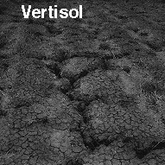
2. Vertisols
Develop on volcanic plateau basalt, trachyte &pyroclastic materials, sedimentary rocks
Heavy clay soils
High natural chemical fertility
Soils of highlands and moderate climates.
Commonly found in parts of;
Northwestern,Central and Southeastern highlands
(Gojjam, Shewa, Arsi, Bale and central Hararghe)

Slide 15
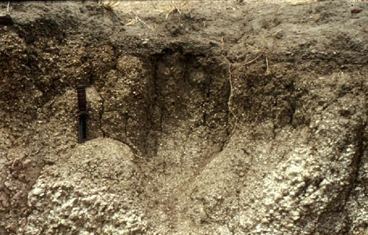
3. Lithosols, Cambisols & Regosol
Mostly found in rugged topography & steep slopes.
Young, shallow and coarse textured
Low water holding capacity
Found in areas of low rainfall
Limited agricultural use
Used for grazing
Mostly found in;
Central Highlands
Rift Valley Escarpments
western Hararghe highlands
Regosol and Lithosols are also found in the Danakil and eastern Ogaden.

Slide 16
4. Xerosols, Yermosols and Solanchaks
Soils of desert
Available in arid and semiarid areas
High salt content and low organic content and nitrogen
Rich in phosphorus and potash
Can be very fertile if irrigated
Xerosols are found in Ogaden and northeastern escarpments
Yermosols and Solonchaks cover the Ogaden and Afar plains
Solonchaks in salty plains of Afar

Slide 17
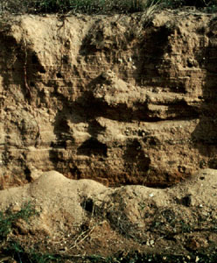
5. Fluvisols
Formed due to deposition of eroded materials from highlands.
Deposits in depressions, lower valleys and lowlands
Much prized for
Intensive agriculture &
Large-scale irrigation
Fertile and their fertility is always renewed as a result of deposition of new soil materials.
Mostly found in;
Lower regions of rivers like Omo, Awash, Abay
The plains of Akobo and Baro Rivers
Lakes region (main Ethiopian rift)

Slide 18
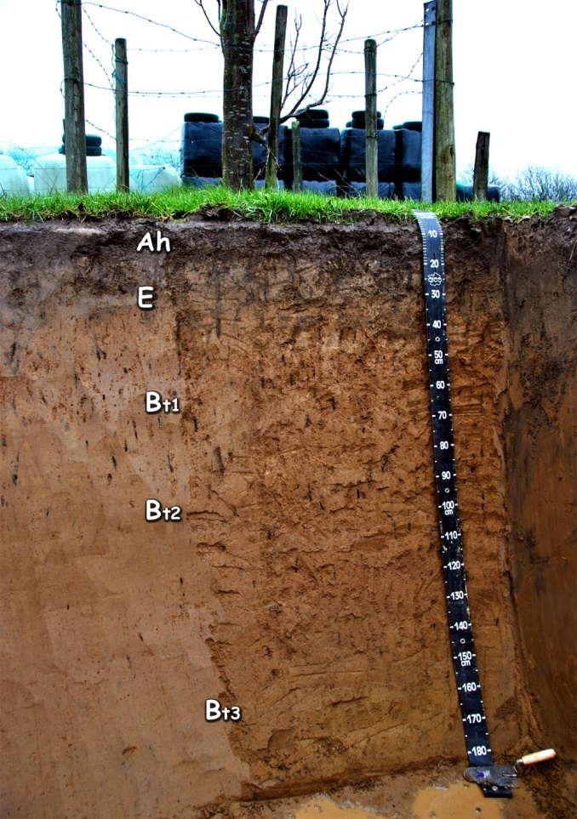
6. Luvisols
Develop in areas where wet and dry seasons occur in alternation
Good chemical nutrients
Among the best agricultural soils in the tropics.
Intensively cultivated
Mostly found in;
Lake Tana area,
parts of Northern, Central and Eastern Highlands and
Southern lowlands

Slide 19
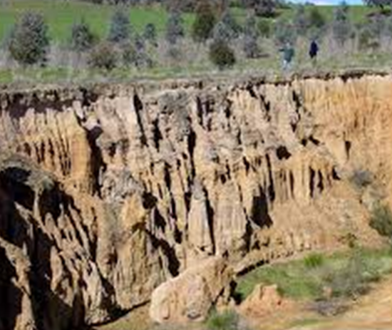
Soil Degradation
A change in any or all of soil status resulting in a diminished capacity of the ecosystem to provide goods and services.
Deterioration of the physical, chemical and biological properties of soil
It is a major concern for at least 2 reasons
It undermines the productive capacity of an ecosystem
It affects global climate through alterations in water and energy balances and disruptions in cycles of carbon, nitrogen, sulfur, and other elements.

Slide 20
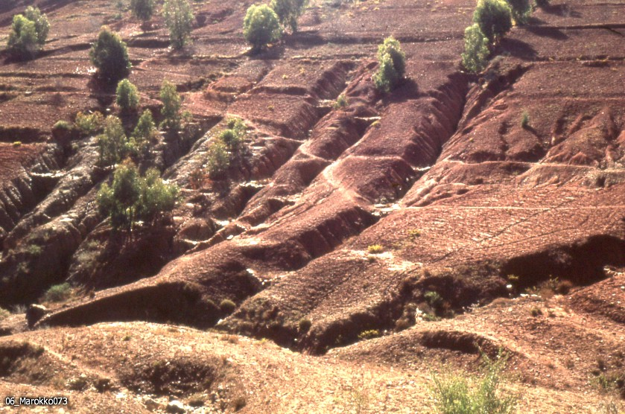
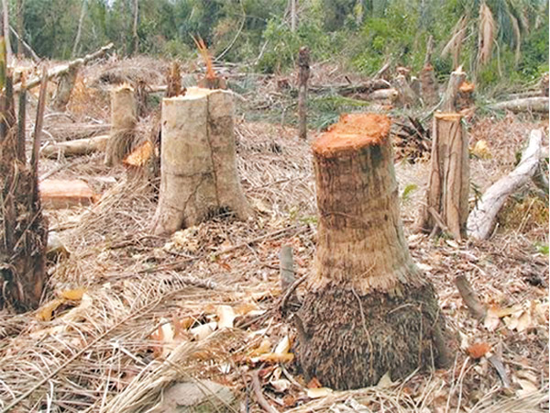
Causes of Soil Degradation
Natural Causes
Human-induced Causes
Topographic and climatic
Steep slopes,
Floods and tornadoes,
Storms and high-velocity wind
Deforestation
Overexploitation of vegetation,
Overgrazing, etc.

Slide 21
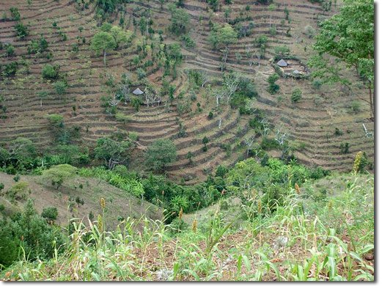
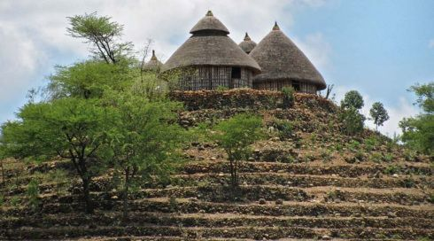
Soil Erosion Control Measures
A. Biological Control Measures
B. Physical control
Used to control the movement of water over the soil surface.
Terracing,
Check Dams,
Gabion,
Trenches,
Contour Ploughing,
Soil Bunds etc.
Prevent splash erosion, reduces the velocity of surface runoff, increases surface roughness, increases infiltration, and etc.
Vegetative strips,
Plantation &
Reforestation

Slide 22
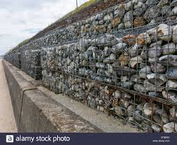
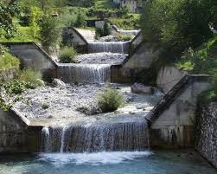
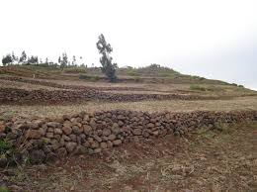
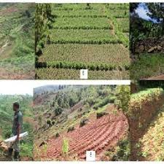

Slide 23
Natural Vegetation of Ethiopia
Natural Vegetation (Meaning)
Grown naturally without human aid
Original plant cover grown in an area
Develops with little or no human interference.
Ethiopia's Natural Vegetation
An estimated number of 6000 species of higher plants (10% are endemic)
The spatial distribution of natural vegetation in the country is strongly correlated to elevation + (temperature and rainfall).
Lowlands are characterized by xeromorphic plants (plants which are adapted to drought) and Ephemeral Annuals.
Highlands (up to 3000 m) = a variety of forests

Slide 24
Major Natural Vegetation Types of Ethiopia
Afro-alpine and sub-afro alpine Region
Forest Region
Woodland Savannah Region
Steppe Region
Semi-desert Region
(Taking altitude into consideration)

Slide 25
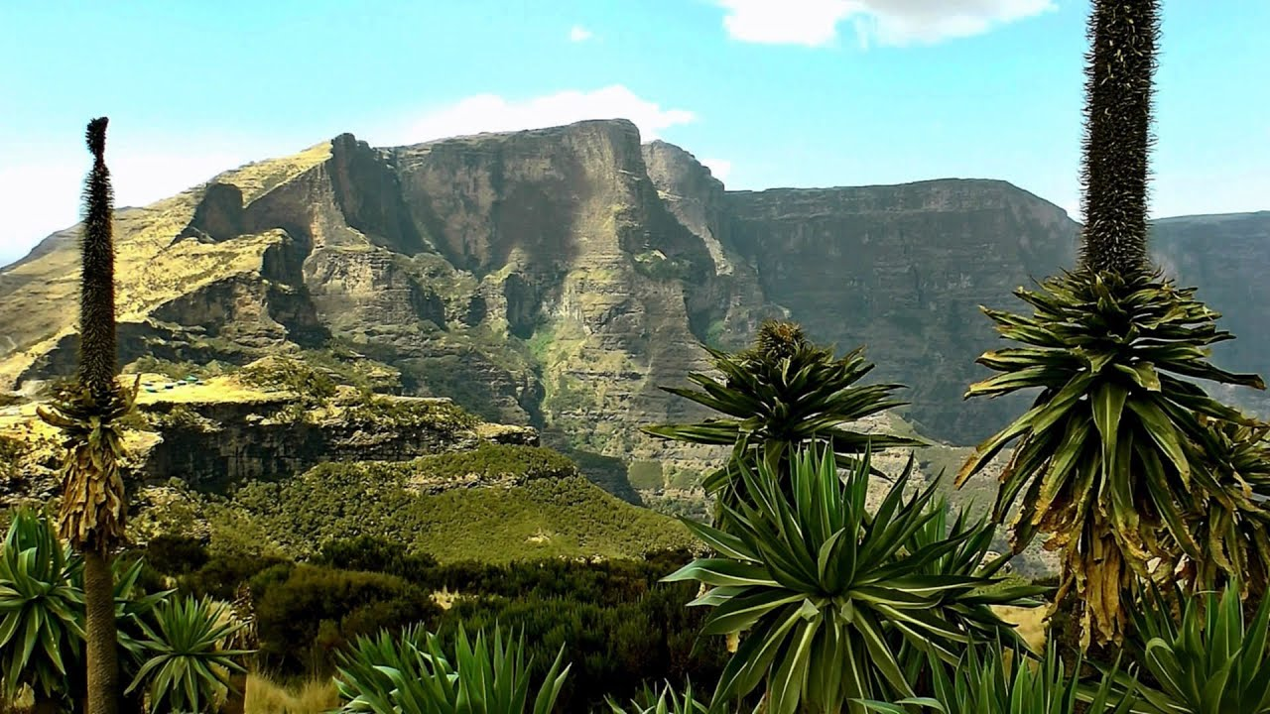
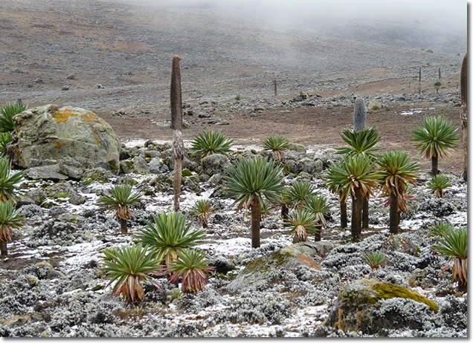
1. Afro-alpine & Sub-afro Alpine Region
High mountain vegetation (3,200 and 4,620 m asl)
similar to the Alpine vegetation in temperate regions
covers 1.3 % of the total landmass of Ethiopia
Temperature records of 0 ^{oC} and below
Soils mostly shallow and eroded
Eg. Vegetations in Bale and Semein mountains
tussock grasslands, scrub, scattered mosses and lichens
Lobelia rhynchopetalum (giberra)

Slide 26
2. Forest Region
In Ethiopia, forests are found at different elevations &rainfall,
Hence Ethiopian forests can classified as:
1. Highland forests include
Kosso (Hagenia Abyssinia),
Tid (Juniper procera),
Kerkha (Arundinaria Alpina),
Zigba (Podocarpus falcatus),
Keraro (Aningeria adolfi-friedericii) and
Weyra (Olea africana) forests;
2. lowland forests
Baphia , Ficus sur (sholla), acacia trees
Gallery (Riverine) Forests (forests that stretch along the banks of the lower courses of rivers)
found in the banks of Awash, Wabishebelle, Ghenale etc..
Notes:
Shallow soil, water logged, frozen soil, insufficient light

Slide 27
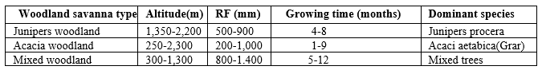
3. Woodland Savannah Region
found (250 to 2,300 m) altitudinal ranges
MAR 200 - 1,400 mm
plants of Xeromorphic characteristics (shading of leaves during the dry season
Shrublands and Bushlands
can be broadly classified into 3 divisions:
Juniper procera (tid)
Acacia woodlands
Mixed deciduous woodlands

Slide 28
4. Steppe and Semi Desert Regions
Arid and semiarid parts of the country where the
temperature is very high and the rainfall very low
low elevations 100 to1,400 m asl
the semi-deserts 125 m bsl to 600 m asl.
Mean Annual Rainfall
The steppe gets MAR100 to 550 mm
The semi desert 50 to 300 mm
Growing period
2 months for the steppe
one month for the semi-deserts
Soils in both regions are generally alkaline and saline.
xerophytic (i.e. drought-resisting plants) are the dominant vegetations.

Slide 29
Natural vegetation Degradation
Ethiopia
Dense Population
Rapid growth of the already dense population
Overexploitation of the land
New land has been cleared at the expense of forests.
Forest resources have been disappearing at an alarming rate.
A century ago, forests covered about 40 percent of the total land area.

Slide 30
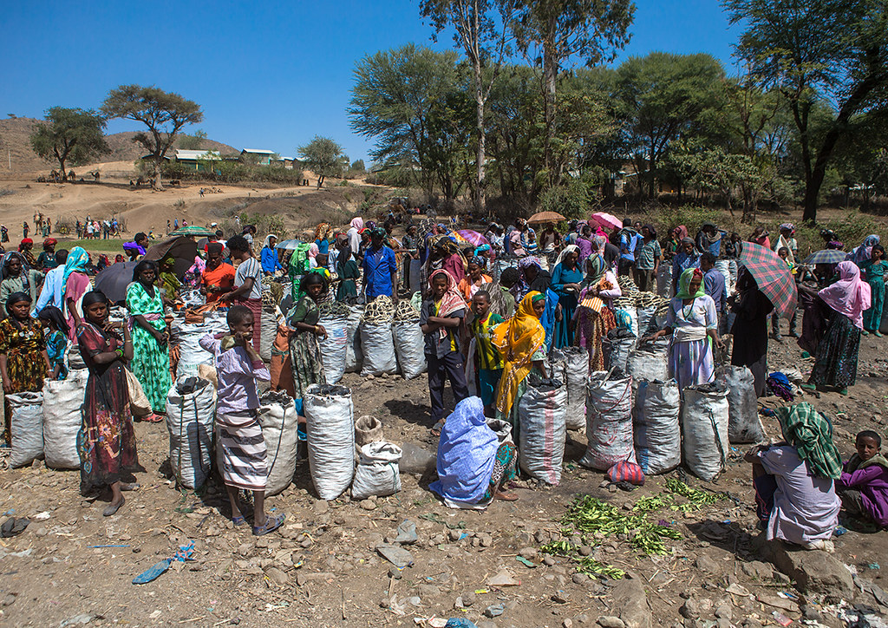
Major Causes
Clearing of forests for cultivation
Timber exploitation practices
Charcoal burning and cutting for fuel
Extensions of coffee and tea production areas
Overgrazing
Expansion of settlements both rural and urban, and
Clearing for construction.

Slide 31
Natural Vegetation Conservation
To maintain at least its current status and derive sustainable benefits for the present and future generation.
3 Approaches of Biodiversity Conservation
Protection
Through designation of sanctuaries, national parks, and community conservation areas.
Sustainable forest management
Sustainable harvesting of forest products to provide a source of financial income
Restoration or rehabilitation
The process of assisting the recovery of a forest ecosystem that has been degraded, damaged, or destroyed.

Slide 32
Wild Life in Ethiopia
Ethiopia’s Wild Life Overview
Existence of wide range of ecosystems
Great varieties of habitats
High faunal diversity
High level of endemicity
Data on faunal resource of the country
860 avian species (16 endemic species and 2 endemic genera)
279 mammalian species (31 endemic species & 6 endemic genera)
201 species of reptiles (14 endemic species),
23 species of amphibians (23 endemic species),
150 freshwater fish (6 endemic species)
The main wild life concentrations in the southern and western parts

Slide 33
Ethiopia’s Wild Life Classification
5 Major Groups:
Common Wild Animals;
Animals found in many parts of the country (hyenas, jackals)
Game (Lowland) Animal
Herbivores like giraffes, wild asses, zebras etc. and
Carnivores like lions, leopards, and cheetahs)
Tree Animals /Arboreals
Monkeys, baboons
Variety of Birds
Found in the Rift Valley lakes

Slide 34
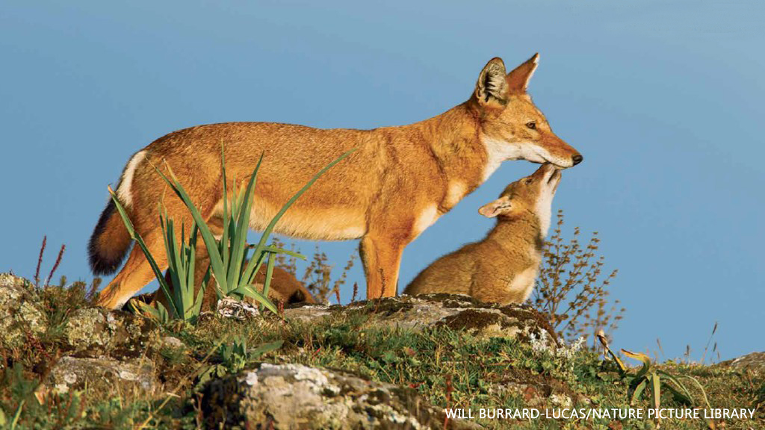
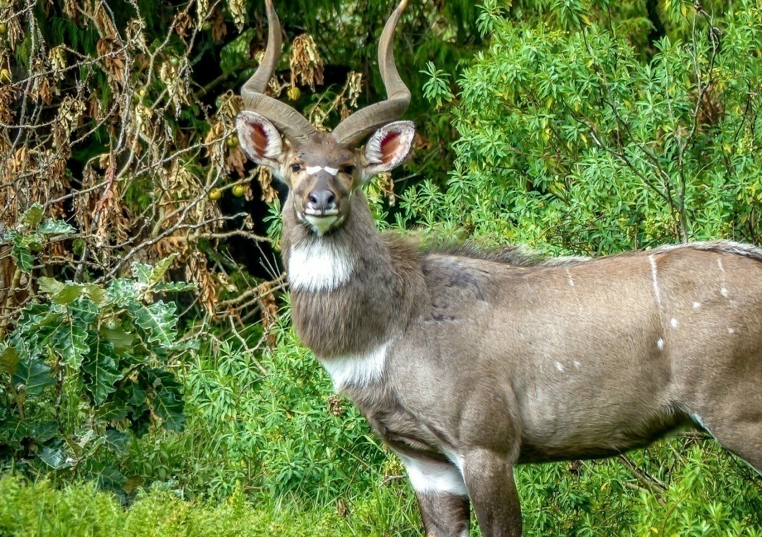
5. Rare Animals
Walia Ibex (Capra walie),
Gelada Baboon (Theropithecus gelada),
Mountain Nyala (Tragelaphus buxtoni),
Ethiopian Wolf (Canissimensis),
Starck’s Hare (Lepus starcki)
Notes:
Gelada baboon and Semien fox) scattered in highlands; walia- ibex in the Semien Massifs, Nyala in the Arsi Bale massifs).

Slide 35
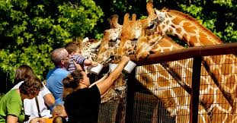
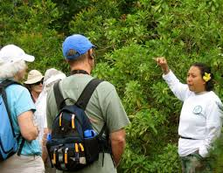
Wildlife Conservation
Why Conservation?
Wild animals can be used for:
Scientific and educational researches
Physical and mental recreation (aesthetic value)
Promotion of tourism (economic value)
Maintaining ecological balance

Slide 36
Wildlife Conservation in Ethiopia
21 major national parks
2 major wildlife sanctuaries
3 wildlife reserves
6 community conservation areas
2 wildlife rescue centers
22 controlled hunting areas
2 botanical gardens, and
3 biosphere reserves

Slide 37
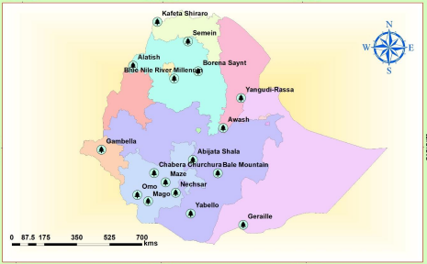
Major National Parks in Ethiopia

Slide 38
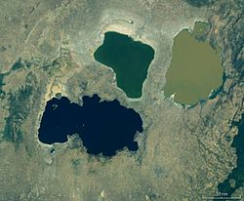
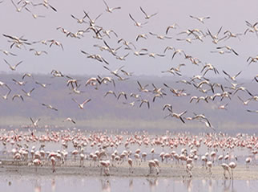
Some of the national parks are unique in their wild animals they have.
Abiyatta-Shalla lakes National Park
predominantly Bird Sanctuary (flamingos and pelicans)

Slide 39
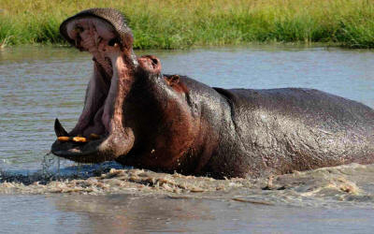
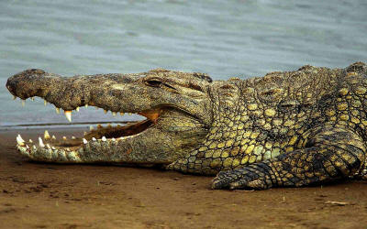
Omo, Mago, and Gambela National Parks
have hippopotamus and crocodiles in rivers and lakes.

Slide 40
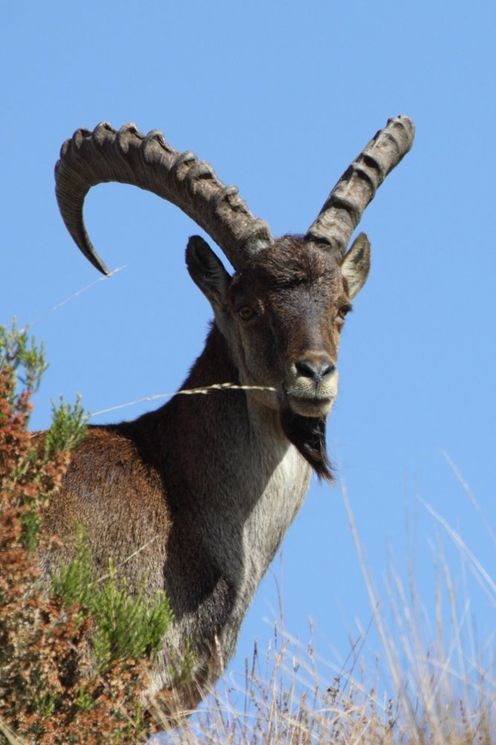
Semien & Bale Mountains National Parks
Rare animals like Walia ibex, Semien fox, gelada baboon & Nyala

Slide 41
Challenges of Wildlife Conservation in Ethiopia
What are the challenges of wildlife conservation in Ethiopia?
Do you know that if you leave nature to its own system, it has notable system of taking care of itself!

Slide 42
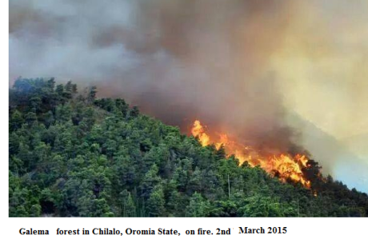
Major challenges Ethiopian protected areas facing;
Limited awareness on the importance of wild life
Expansion of human settlement in protected areas.
Conflict over resource
Overgrazing (fodder and wood)
Illegal wildlife trade
Excessive hunting
Tourism and recreational pressure
Mining and construction material extraction
Forest fire

Slide 43
End of Chapter 6!

